Slide 1

LOAN
PREDICTION

Slide 2

Agenda
01
Introduction
02
Problem Statement
03
Project Objective
04
Data Acquisition And Exploration
05
Data Preprocessing
06
Model Development And Evaluation
07
Results And Discussion
08
Conclusion

Slide 3


INTRODUCTION

Slide 4
The ability to accurately predict loan approval or default is crucial for financial institutions. Loan prediction models help aut﻿omate and streamline the loan approval process, mitigate risk, and optimize resource allocation. These models leverage historical data and machine learning algorithms to assess the creditworthiness of potential borrowers.
FINANCIAL INCLUSION
RISK MANAGEMENT
Operational Efficiency
Loan prediction models can help expand access to credit for underserved populations by providing alternative means of assessing creditworthiness beyond traditional credit scoring methods. This can empower individuals and small businesses.
By identifying potential loan defaults, financial institutions can implement appropriate risk mitigation strategies. This can involve adjusting interest rates, requiring collateral, or offering tailored financial products and services to borrowers with varying risk profiles.
Automating the loan approval process through predictive models can significantly reduce processing time and human resource requirements. This allows financial institutions to handle larger volumes of loan applications efficiently

Slide 5

Financial institutions face the critical challenge of accurately assessing the creditworthiness of potential borrowers. Traditional loan approval processes often rely on manual assessments and credit scoring methods that can be time-consuming, subjective, and limited in their predictive power.
Problem Statement
This can lead to inaccurate loan approval decisions, resulting in financial losses due to defaults and missed opportunities to serve creditworthy borrowers.
Therefore, the problem this project addresses is the development of a robust and accurate loan prediction model that can effectively assess the likelihood of a borrower repaying a loan.
This model will leverage historical loan data and machine learning techniques to identify key factors influencing loan repayment and predict future loan outcomes.

Slide 6
Identify and analyze the factors that significantly influence loan approval and default.
Problem Statement
Develop and compare different machine learning models for loan prediction.
Optimize model performance through hyperparameter tuning and feature engineering.
Evaluate the model'sgeneralizability and robustness

Slide 7
Project Objectives
Develop a machine learning model to predict loan approval or default
Evaluate
the model's generalizability and
robustness.
Develop a user-friendly interface or dashboard
Identify the key factors influencing loan repayment
Optimize model performance

Slide 8
DATA ACQUISITION AND EXPLORATION

Slide 9

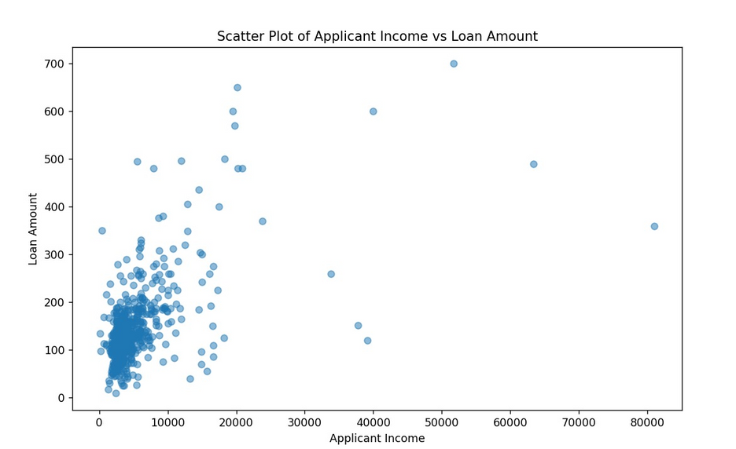
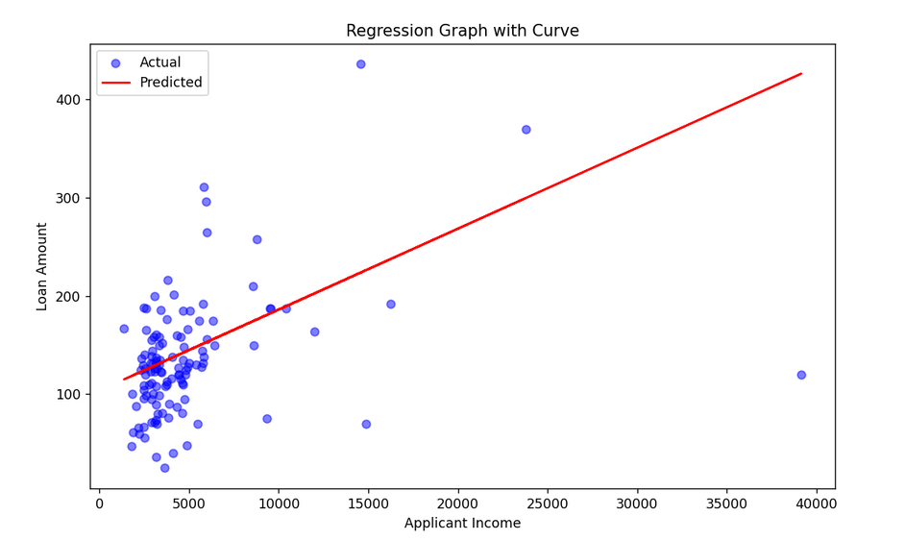

Slide 10
DATA PREPROCESSING

Slide 11


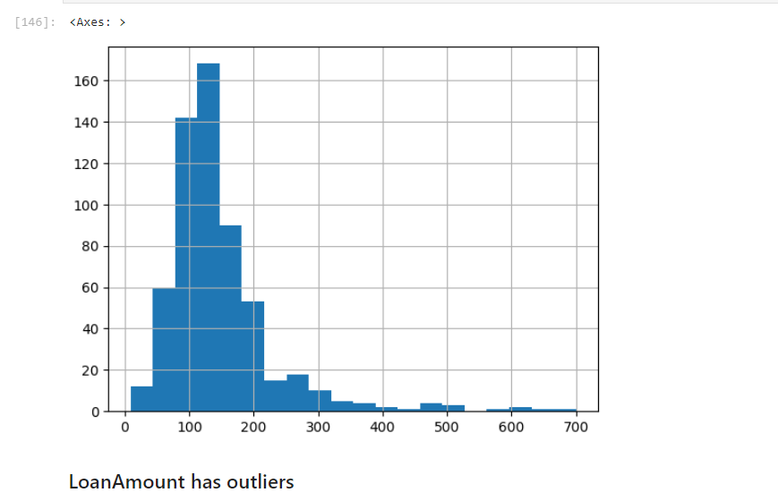
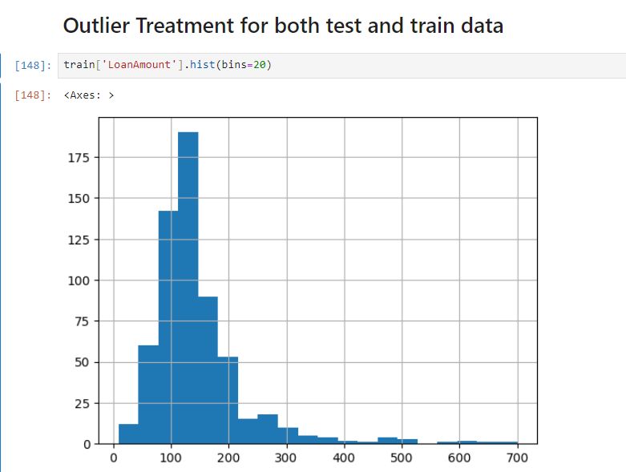

Slide 12
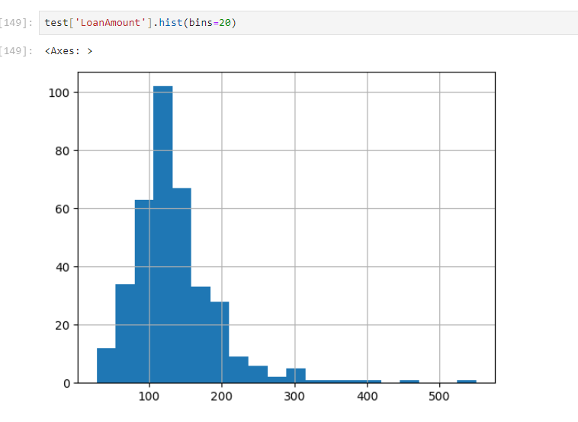
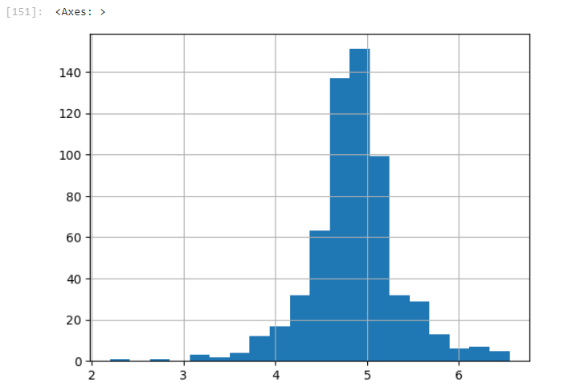

Slide 13
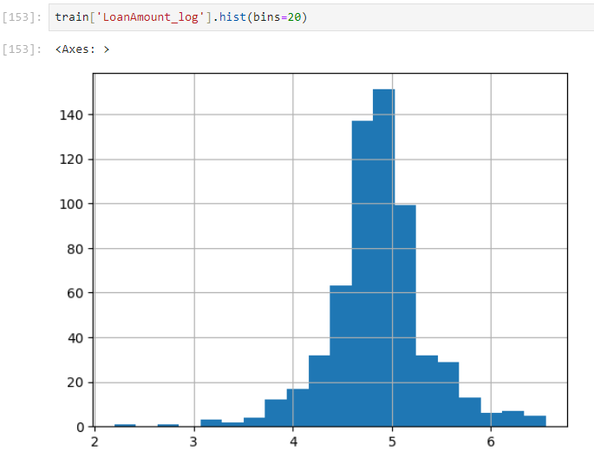

Slide 14
Model Development and Evaluation

Slide 15
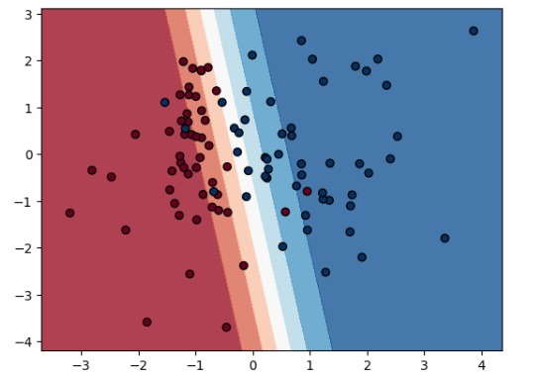
LOGISTIC REGRESSION
Binary Outcome:
Logistic regression is ideal for predicting loan approval because it forecasts a binary outcome - yes (loan approved) or no (loan rejected).
Probability Estimation:
Unlike linear regression which predicts a specific value, logistic regression estimates the probability of an event (loan approval) happening based on the applicant's features. This probability helps lenders assess the risk of approving the loan.
Model Building & Interpretation:
This model can then be used to predict the probability of approval for new loan applications based on past loan decisions.

Slide 16
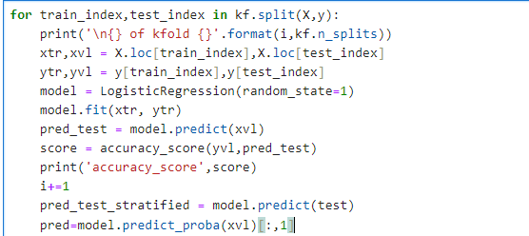

Model Implementation

Slide 17
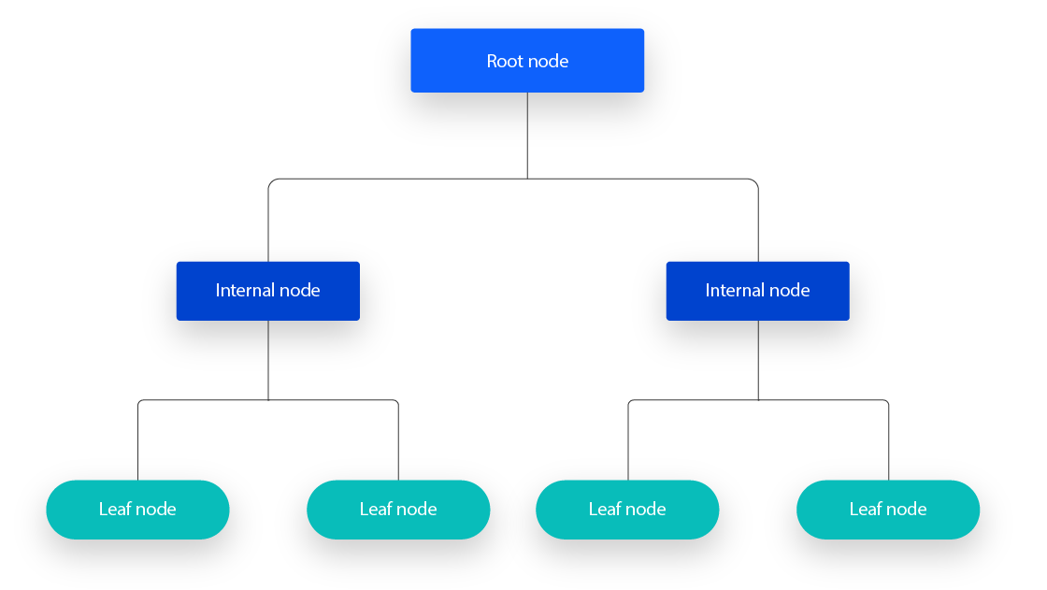
DECISION TREE
Tree-like Structure:
A decision tree resembles a flowchart, with each node representing a question based on an applicant's characteristic (income, credit history, etc.). The answer to the question determines which branch (yes/no) leads to the next decision node.
Sequential Splitting:
The decision tree is built by splitting the data based on the most informative feature at each step. This feature is the one that best separates applicants into groups with distinct loan repayment behavior
Clear & Transparent:
Decision trees offer clear reasoning behind their predictions. You can follow the path through the tree for any applicant to understand why a certain loan approval decision was made. This transparency can be helpful for lenders in explaining their decisions.

Slide 18
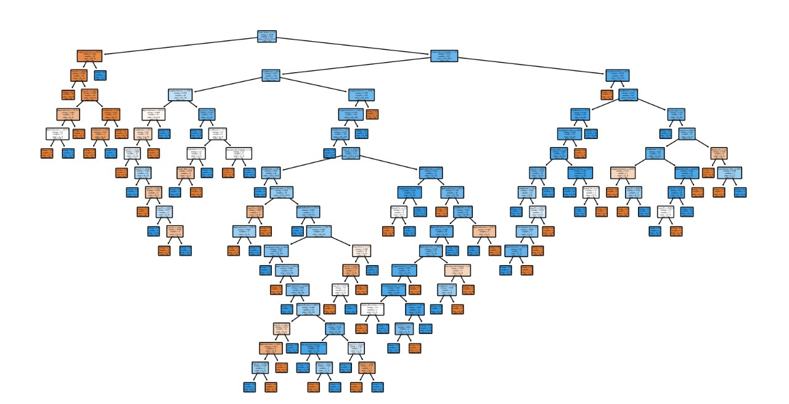

Slide 19
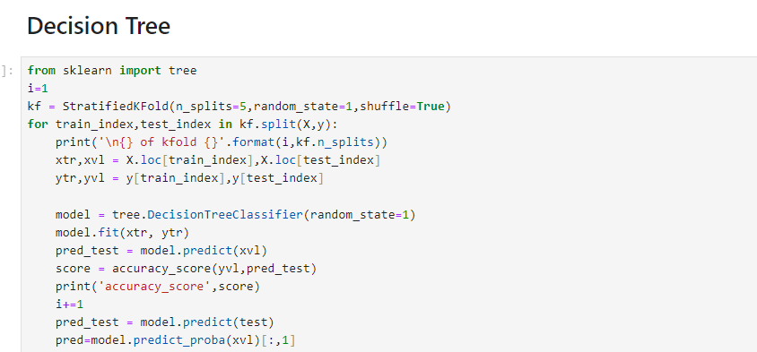
Model Implementation

Slide 20
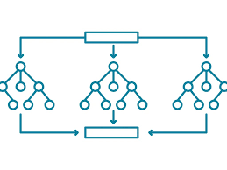
RANDOM FOREST
Ensemble of Decision Trees:
Random Forest is a powerful technique that combines multiple decision trees, creating a "forest" of predictors. Each tree is built using a random subset of features and data points, making them diverse and less prone to overfitting.
mproved Accuracy & Reduced Overfitting:
By combining predictions from numerous uncorrelated trees, Random Forest reduces the variance and often achieves higher accuracy compared to a single decision tree.
Feature Importance & Flexibility:
Random Forest goes beyond just predicting loan approval. It calculates the importance of each feature (income, credit score, etc.) in making the prediction. This helps lenders understand which factors most influence loan risk.

Slide 21
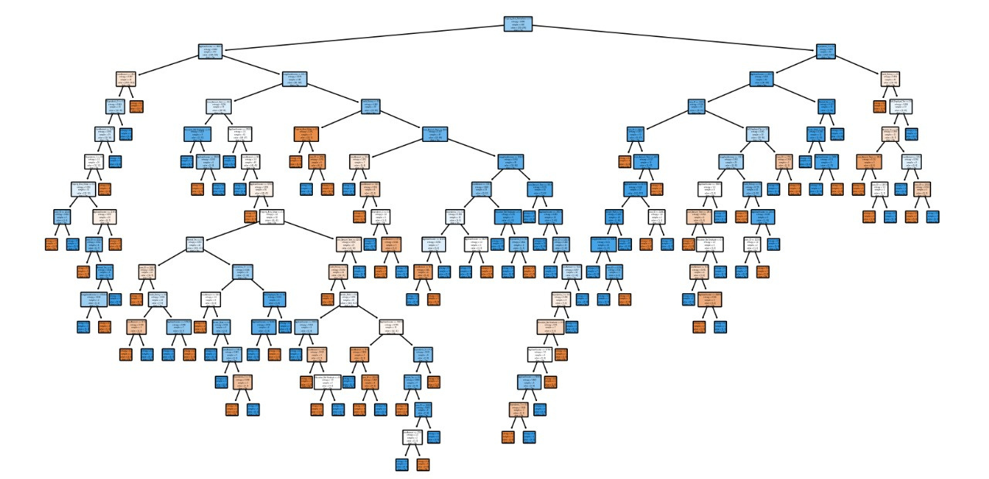

Slide 22
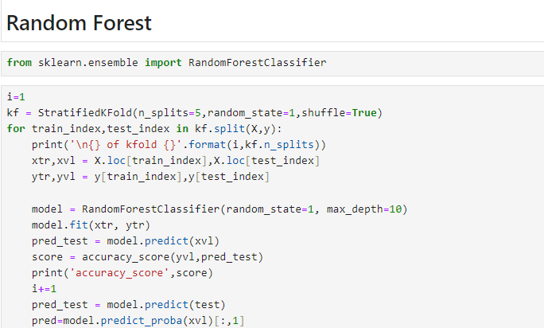
Model Implementation

Slide 23
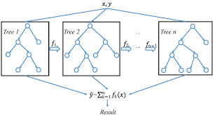
XGBOOST
Supercharged Decision Trees:
XGBoost builds on the strengths of decision trees by using a technique called "gradient boosting." It creates a sequence of improved decision trees, each focusing on correcting the errors of the previous ones, leading to highly accurate predictions for loan approval or default.
Regularization & Performance:
XGBoost incorporates "regularization" techniques that prevent overfitting. This helps the model perform well on unseen data, crucial for reliable loan risk assessment.
Scalability & Explainability:
XGBoost handles large datasets efficiently and provides some level of feature importance analysis, similar to Random Forest. This allows lenders to understand the key factors influencing loan risk predictions.

Slide 24
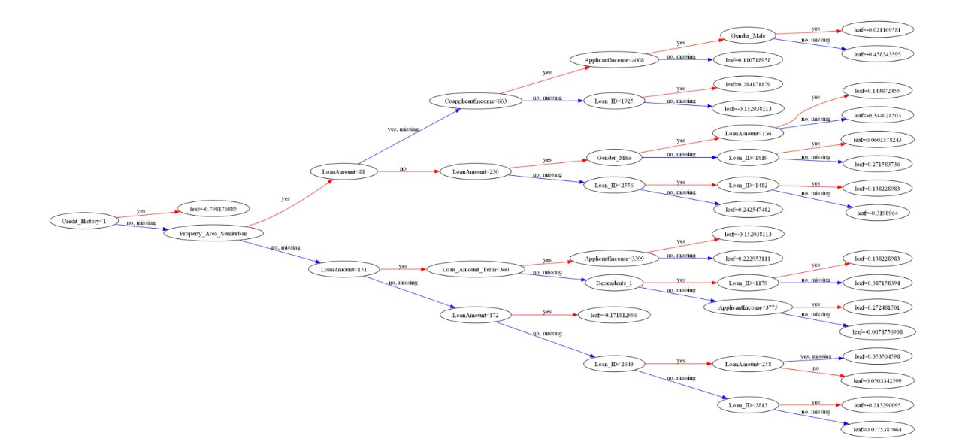
Accuracy:73%

Slide 25
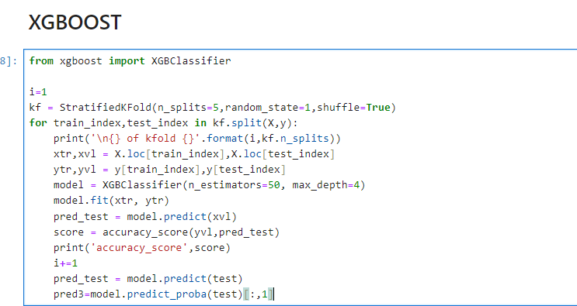
Model Implementation

Slide 26
RESULTS
AND
DISCUSSIONS

Slide 27




LOGISTIC REGRESSION
DECISION TREE
Model Performance Comparison
RANDOM FOREST
XGBOOST

Slide 28
Model Complexity & Interpretability:
Decision Tree: Simple and easy to understand, with clear decision rules for loan approval. Can be prone to overfitting. (Most Interpretable)
Logistic Regression: Straightforward model, but the relationship between features and loan approval is less intuitive compared to a decision tree. (Interpretable)
Random Forest: Combines multiple trees, making interpretation more complex. Offers feature importance for understanding key factors. (Moderately Interpretable)
XGBoost: Most complex model, with interpretation requiring feature importance analysis. (Least Interpretable)

Slide 29
Accuracy & Performance:
Decision Tree: Can be accurate but susceptible to overfitting, leading to poor performance on unseen data.
Logistic Regression: Good accuracy for binary prediction, but may not capture complex relationships in the data.
Random Forest: Generally more accurate than a single decision tree due to reduced variance and overfitting.
XGBoost: Often achieves the highest accuracy due to its ensemble learning approach and regularization techniques.

Slide 30
Suitability for Loan Prediction:
Decision Tree: Good for initial exploration and understanding key factors affecting loan approval. May not be ideal for final loan decisions due to overfitting concerns.
Logistic Regression: Solid choice if interpretability is important and the data has a linear relationship between features and loan approval.
Random Forest: A strong option for balancing interpretability with accuracy, making it well-suited for loan prediction.
XGBoost: Offers the highest potential accuracy but requires more expertise to fine-tune and interpret. Great choice when top-notch performance is crucial.

Slide 31
Key Findings and Insights
Credit History Dominance: Credit history emerged as the most influential factor in loan approval decisions, emphasizing the importance of past financial behavior in assessing creditworthiness.
Income and Employment Stability: Applicants with stable income sources and employment histories were more likely to secure loan approval, highlighting the significance of financial stability in lending decisions.
Debt-to-Income Ratio: The debt-to-income ratio proved to be a crucial metric, indicating the balance between an applicant's existing debt obligations and their ability to take on additional debt, thus influencing loan approval outcomes significantly.
Impact of Demographic Factors: While demographic factors such as age, gender, and location played a role in loan approval, their influence varied across different models, suggesting the need for nuanced considerations in assessing credit risk.
Model Interpretability: Employing interpretable machine learning techniques allowed for deeper insights into the factors driving loan approval decisions, facilitating transparency and trust in the predictive models deployed.

Slide 32
Conclusion

Slide 33
In conclusion, our loan prediction project has successfully developed a reliable machine learning model for assessing loan approval likelihood with high accuracy. By optimizing algorithms and prioritizing interpretability, we've empowered lenders to make informed decisions efficiently.
This project's impact extends beyond technical achievements, offering practical solutions to streamline lending processes and enhance risk management in the financial industry. Looking ahead, further innovations can refine our approach and adapt to evolving market dynamics, ensuring continued relevance and effectiveness.
In essence, our project highlights the transformative potential of data-driven decision-making, fostering a more inclusive and resilient financial ecosystem through collaboration, innovation, and a commitment to excellence.

Slide 34
thank you
Saurav Kumar-2128054
Samay Singh-2128126

